Slide 1
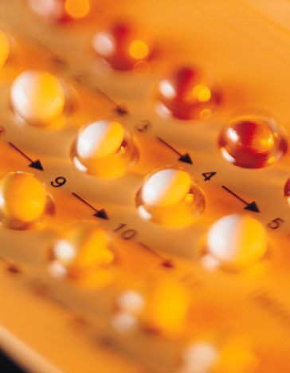
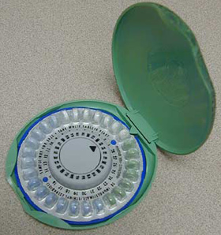
Oral Contraceptive Pill
The standard pill combines estrogen and progesterone
Mimics pregnancy and this stops ovulation
Needs to be taken every day
The mini pill contains only progesterone
Thickens cervical mucus preventing entry of sperm
Need to be taken every day at the same time

Slide 2
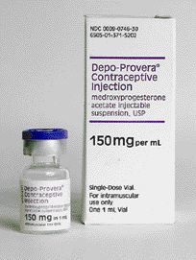
Depo-Provera
Injectable form of progesterone
Thickens cervical mucus and stops ovulation
Injection required every three months

Slide 3
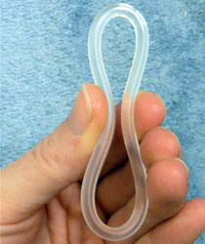
NuvaRing
Inserts into vagina once a month and is left for three weeks
Secretes estrogen and progesterone

Slide 4

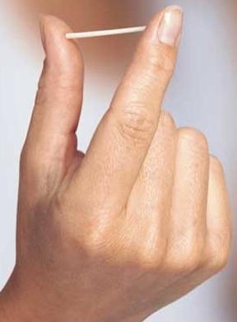
Implanon and Patches
Implanted under skin using local anaesthetic
Secretes progesterone
Provides 3 to 5 years of protection
Video

Slide 5
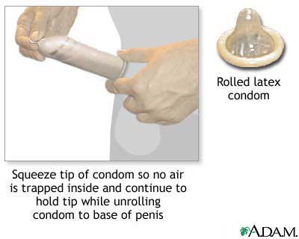
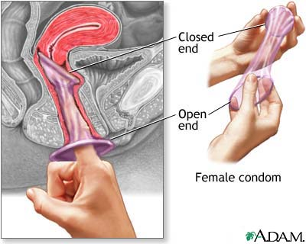
Condoms and Femidoms
Prevent sperm from entering uterus
Only form of contraception that protects against sexually transmitted infections

Slide 6
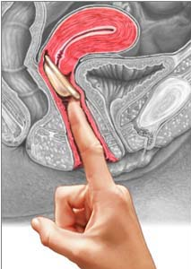
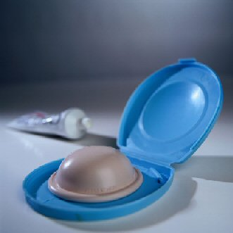
Diaphragm and Cervical Cap
Used with spermicide
Must be left in place for 6 to 8 hours after ejaculation

Slide 7
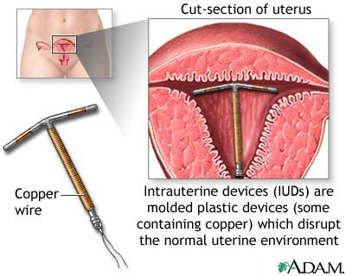
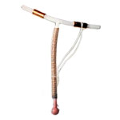
Intrauterine device (IUD)
Irritates lining of the uterus, which interferes with implantation
Inserted by a health professional
Two strings hang into the vagina
May be left in place for 5 to 10 years
Video

Slide 8
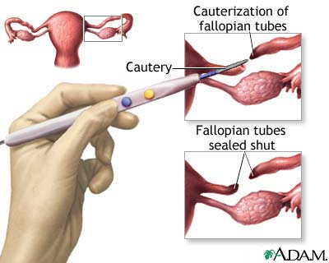
Tubal Ligation
Permanent birth control
Fallopian tubes are cut to prevent fertilisation of sperm and egg

Slide 9
Vasectomy
Permanent birth control
Vas deferens are cut to prevent sperm being ejaculated
Requires local or general anaesthesia
Video

